Slide 1











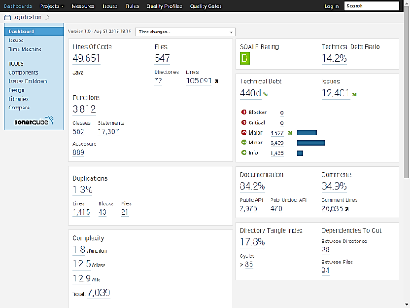
Code Quality Control Process - Automation
SVN Hook
54 Rules
SVN Server
http
Developer
Jenkins
Planned
Assign violations
Assignment Job
http

